Slide 1
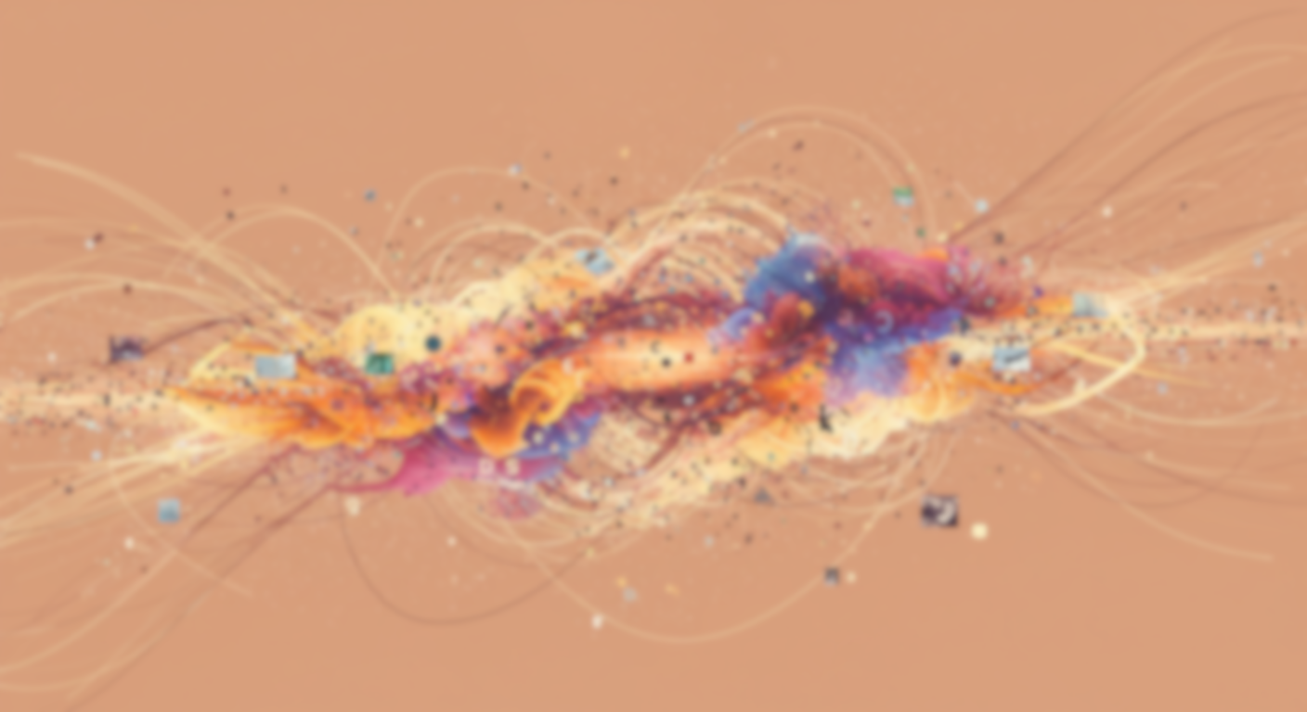

PROBABILISTIC LANGUAGE-IMAGE PRE-TRAINING
Chun, Sanghyuk, Wonjae Kim, Song Park, and Sangdoo Yun. "Probabilistic Language-Image Pre-Training." ICLR25

Slide 2
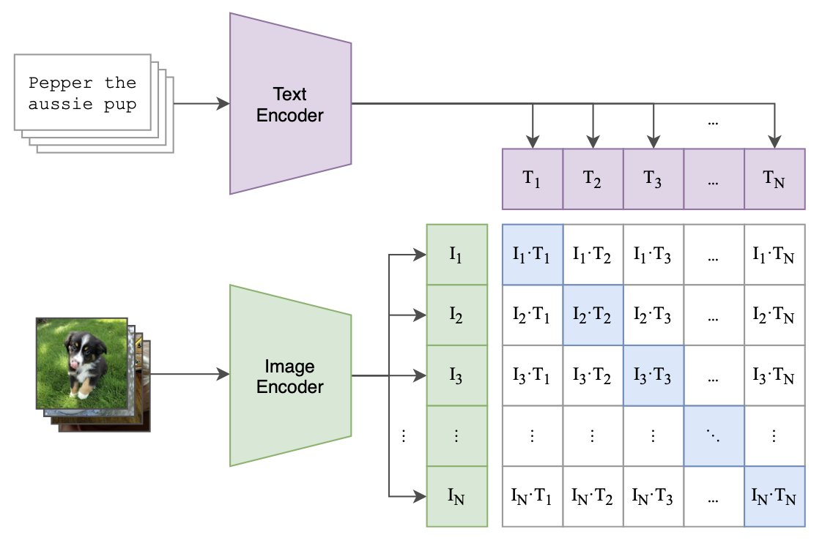
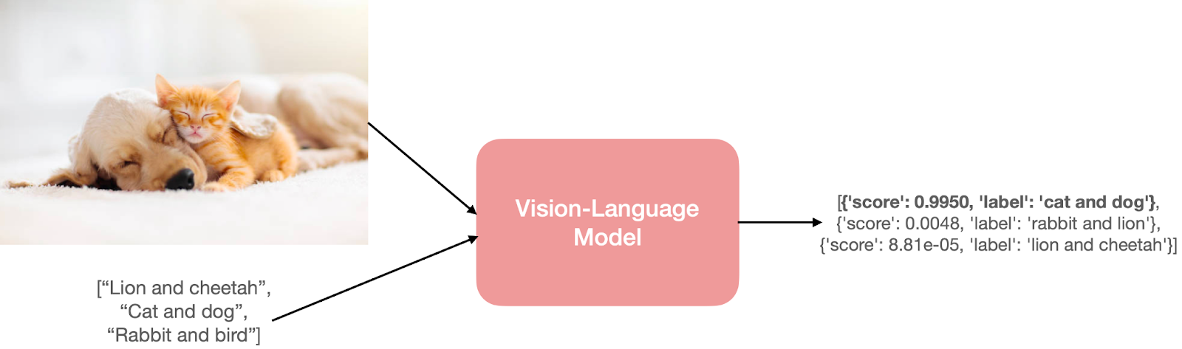
Background : Vision-language models (VLMs)
Vision-language model: Aligns image-text pairs into a joint space.
VLMs achieves success in downstream tasks:
Zero-shot classification
Image-text cross-modal retrieval
Contrastive learning

Slide 3
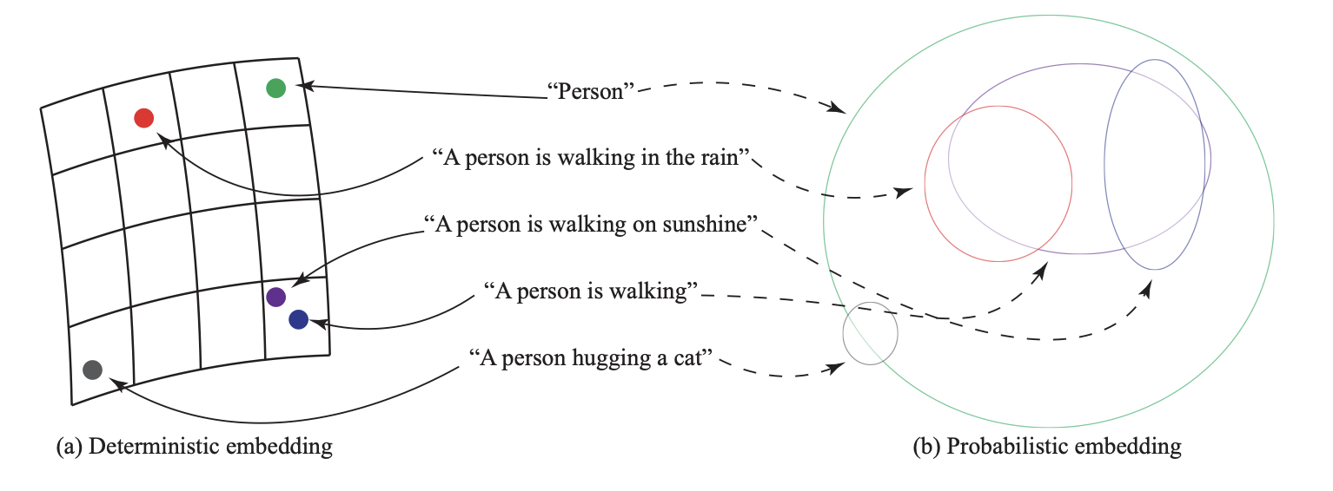
Problem Statement (1/2): Why do we need probabilistic representations ?
VLM: Encode representations into a deterministic Euclidean space.
One-to-one correspondence between images and texts

Slide 4
Problem Statement (1/2): Why do we need probabilistic representations ?
VLM: Encode representations into a deterministic Euclidean space.
One-to-one correspondence between images and texts
In practice: Many-to-many
One image = Many captions
One caption = Many images

Slide 5
Problem Statement (1/2): Why do we need probabilistic representations ?
VLM: Encode representations into a deterministic Euclidean space.
Fails to capture the
multiplicity
In practice: Many-to-many
One image = Many captions
One caption = Many images

Slide 6
Problem Statement (1/2): Why do we need probabilistic representations ?
PrVLM (Probabilistic VLM): Map an input to a random variable.

Slide 7
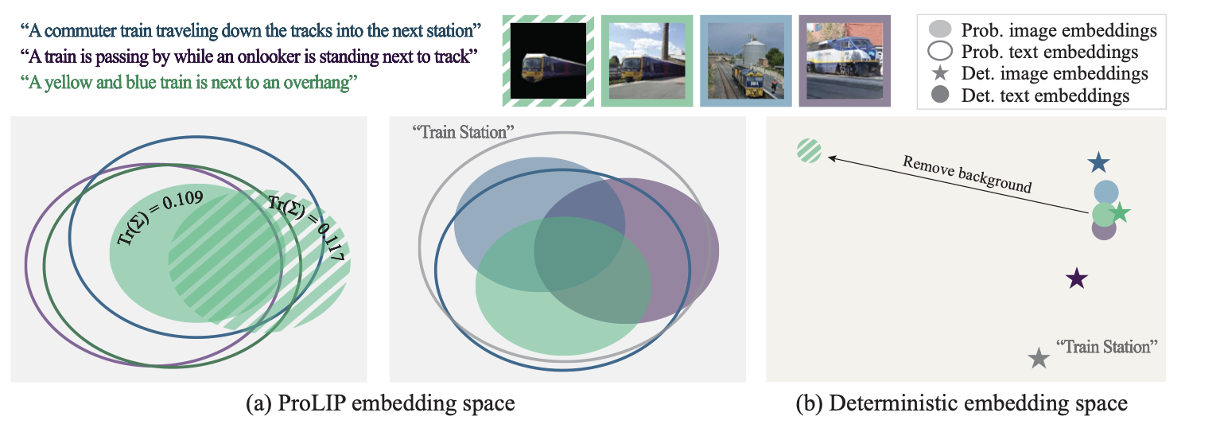
Problem Statement (2/2): Probabilistic image-text representations

Slide 8
Problem Statement (2/2): Probabilistic image-text representations
Deterministic text and image embeddings
Deterministic text and image embeddings

Slide 9
Problem Statement (2/2): Probabilistic image-text representations
Deterministic text and image embeddings
Probabilistic text and image embeddings

Slide 10
Problem Statement (2/2): Probabilistic image-text representations
W/ and w/o background representations are overlapping
Not robust to background removal

Slide 11
Problem Statement (2/2): Probabilistic image-text representations
More specific representations are included in the “Train station” representation
”Train station” representation is far from more specific representations

Slide 12
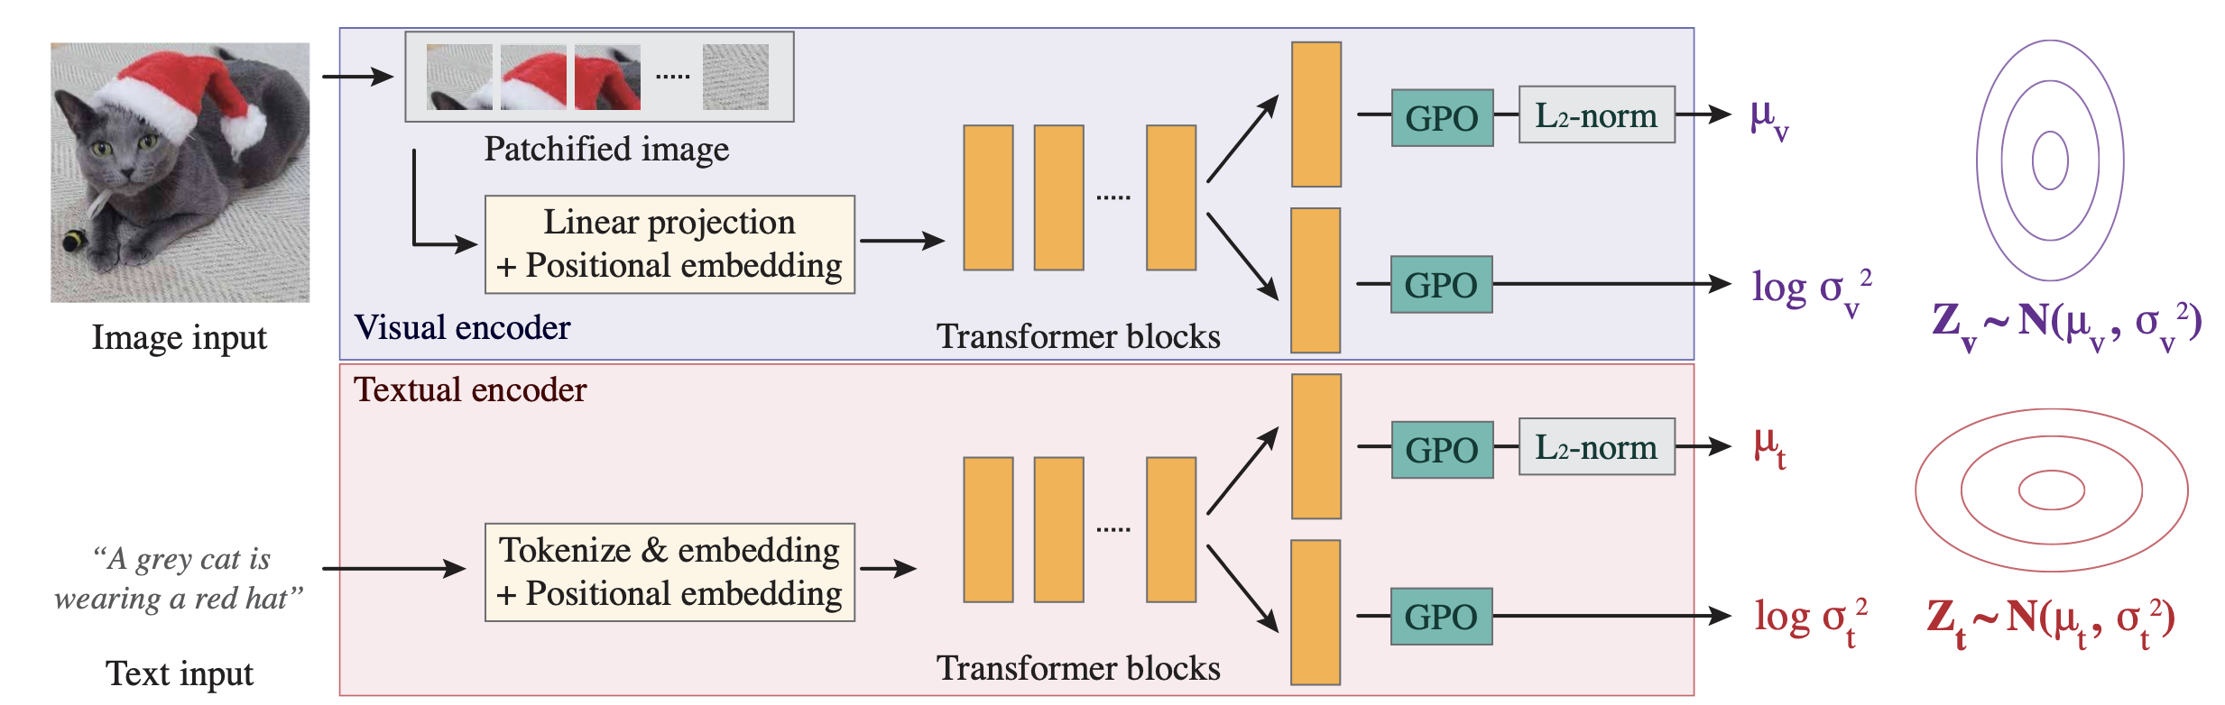
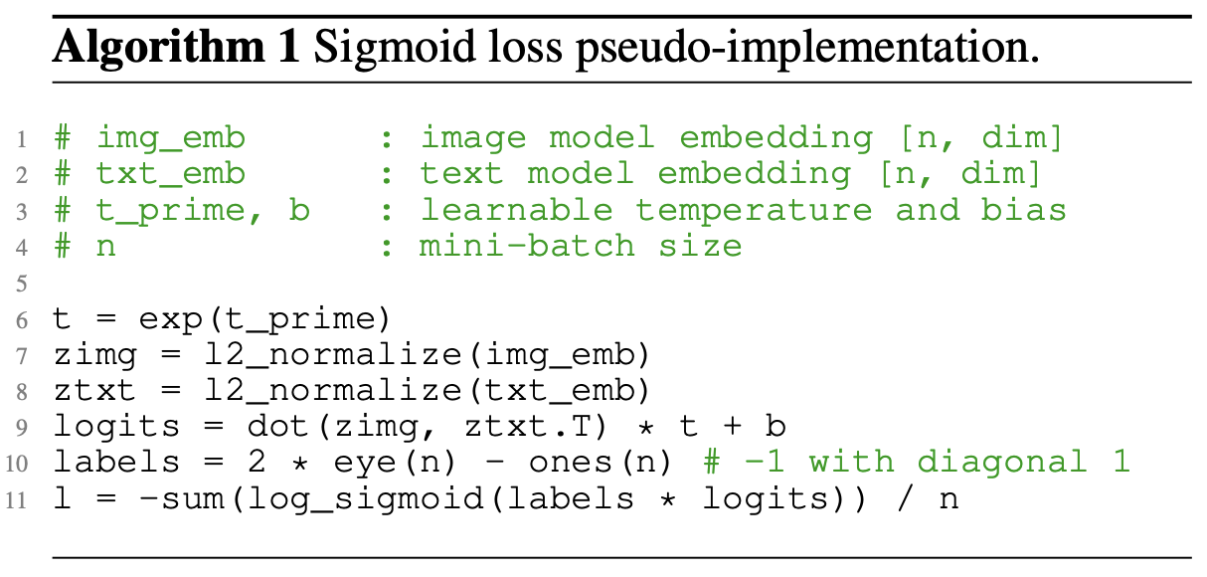
Related Works: VLM and PrVLM
CLIP [Radford+, ICML21] | Multimodal model aligns images and text through contrastive learning.
SigLIP [Zhai+, ICCV23] | Pairwise Sigmoid loss for Language-Image Pre-training.
PCME++ [Chun, ICLR24] | Probabilistic image-text matching model.
SigLIP [Zhai+, ICCV23]
PCME++ [Chun, ICLR24]

Slide 13
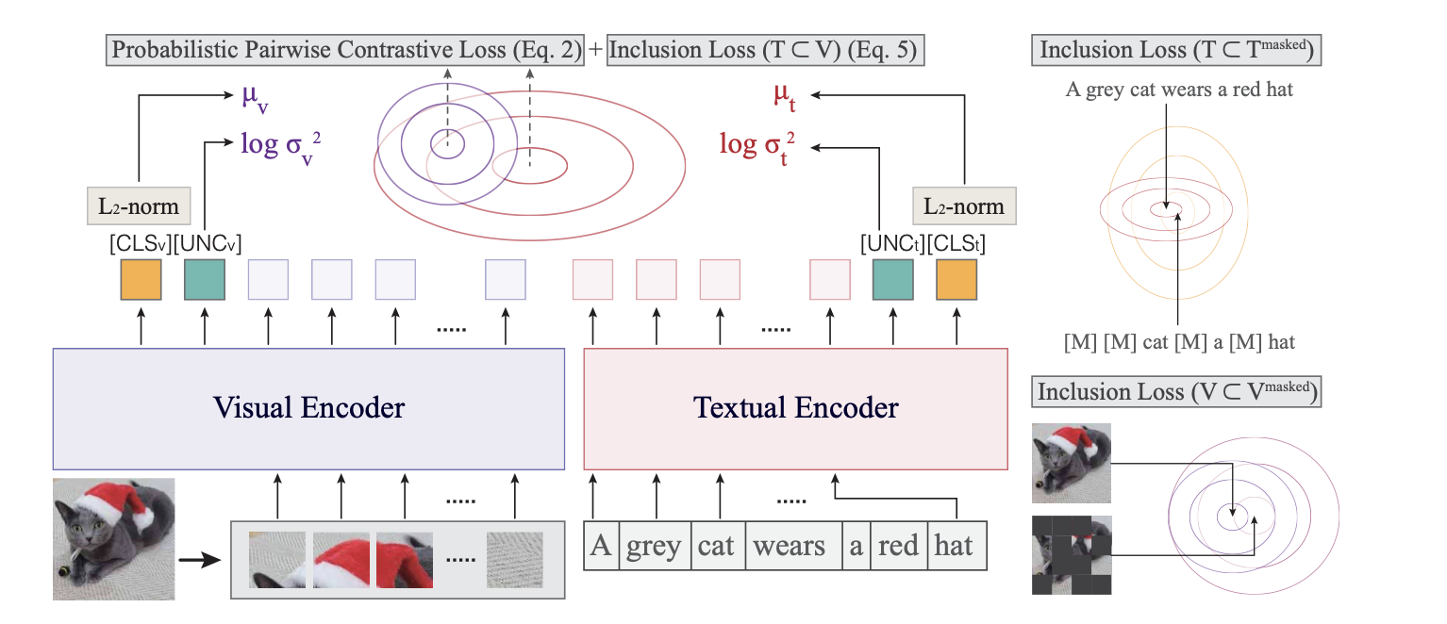
Proposed Method: ProLIP – Model architecture
ViT image encoder and Transformer textual encoder.

Slide 14
Proposed Method: ProLIP – Model architecture
[CLS] token to represent the mean.
New [UNC] token to represent the uncertainty.

Slide 15
Proposed Method: ProLIP – Model architecture
The parameters of a normal distribution are extracted from these two tokens
[CLS] token to represent the mean.
New [UNC] token to represent the uncertainty.

Slide 16
Proposed Method: ProLIP – Model architecture
New loss function composed of PPCL and Inclusion loss

Slide 17
Proposed Method: ProLIP – Probabilistic pairwise contrastive loss (PPCL)
GOAL: Compute the loss between the text distribution and the image distribution.

Slide 18
Proposed Method: ProLIP – Probabilistic pairwise contrastive loss (PPCL)
GOAL: Compute the loss between the text distribution and the image distribution.
Let define,
with diagonal covariance matrices.

Slide 19
Proposed Method: ProLIP – Probabilistic pairwise contrastive loss (PPCL)
GOAL: Compute the loss between the text distribution and the image distribution.
Let define,
with diagonal covariance matrices.
(see appendix)
Then,
(1)

Slide 20
Proposed Method: ProLIP – Probabilistic pairwise contrastive loss (PPCL)
GOAL: Compute the loss between the text distribution and the image distribution.
Let define,
with diagonal covariance matrices.
Then,
(1)
For stability and alignment with contrastive learning we want to reformulate to a cosine similarity

Slide 21
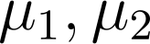
Proposed Method: ProLIP – Probabilistic pairwise contrastive loss (PPCL)
GOAL: Compute the loss between the text distribution and the image distribution.
Let define,
with diagonal covariance matrices.
Then,
(1)
Also,
(2)
with and L2-normalized

Slide 22
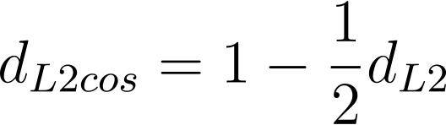
Proposed Method: ProLIP – Probabilistic pairwise contrastive loss (PPCL)
GOAL: Compute the loss between the text distribution and the image distribution.
Let define,
with diagonal covariance matrices.
Then,
(1)
Also,
(2)
with and L2-normalized
Then,
describe a cosine similarity so we will consider

Slide 23
Proposed Method: ProLIP – Probabilistic pairwise contrastive loss (PPCL)
GOAL: Compute the loss between the text distribution and the image distribution.
Let define,
with diagonal covariance matrices.
Then,
(1)
Also,
(2)
with and L2-normalized
So, by combining (1) and (2),

Slide 24
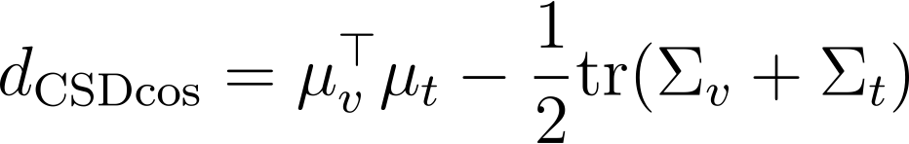
Proposed Method: ProLIP – Probabilistic pairwise contrastive loss (PPCL)
GOAL: Compute the loss between the text distribution and the image distribution.
Let define,
with diagonal covariance matrices.
Then,
(1)
Also,
(2)
with and L2-normalized
So, by combining (1) and (2),
Finally,
(3)

Slide 25
Proposed Method: ProLIP – Probabilistic pairwise contrastive loss (PPCL)
GOAL: Compute the loss between the text distribution and the image distribution.
Also, for stability and flexibility we consider with $a$ and $b$ being learnable scalars:

Slide 26
Proposed Method: ProLIP – Probabilistic pairwise contrastive loss (PPCL)
GOAL: Compute the loss between the text distribution and the image distribution.
Also, for stability and flexibility we consider with $a$ and $b$ being learnable scalars:
By construction,
with diagonal covariance matrices.

Slide 27
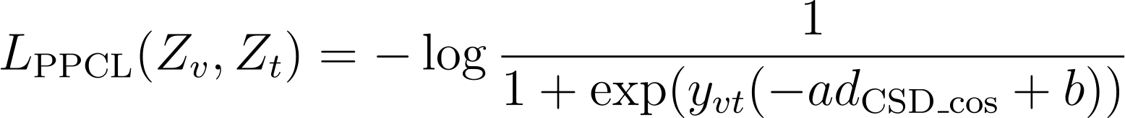
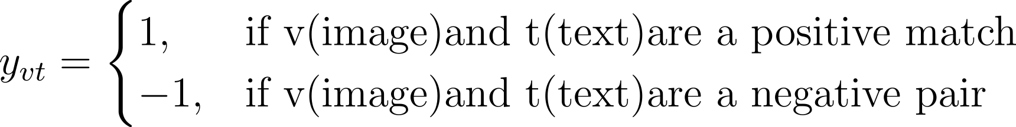
Proposed Method: ProLIP – Probabilistic pairwise contrastive loss (PPCL)
GOAL: Compute the loss between the text distribution and the image distribution.
Also, for stability and flexibility we consider with $a$ and $b$ being learnable scalars:
By construction,
with diagonal covariance matrices.
Following SigLIP, we employ log sigmoid loss to get the final PPCL loss:
With,

Slide 28
Proposed Method: ProLIP – Probabilistic pairwise contrastive loss (PPCL)
GOAL: Compute the loss between the text distribution and the image distribution.
Also, for stability and flexibility we consider with $a$ and $b$ being learnable scalars:
By construction,
with diagonal covariance matrices.
Following SigLIP, we employ log sigmoid loss to get the final PPCL loss:
With,

Slide 29
Proposed Method: ProLIP – Inclusion Loss
IDEA: If text/image loses information (masked), the original sample distribution should be included in the masked distribution.

Slide 30
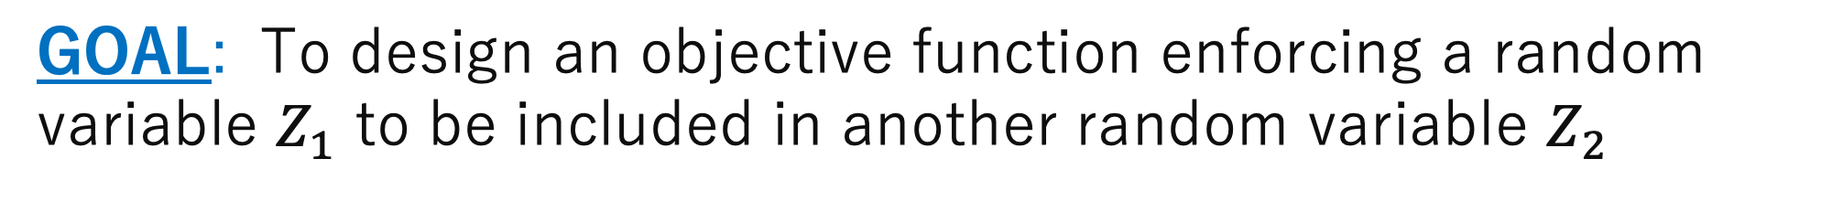
Proposed Method: ProLIP – Inclusion Loss
IDEA: If text/image loses information (masked), the original sample distribution should be included in the masked distribution.
GOAL: To design an objective function enforcing a random variable $Z_{1}$ to be included in another random variable $Z_{2}$

Slide 31
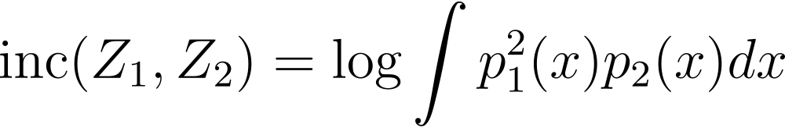
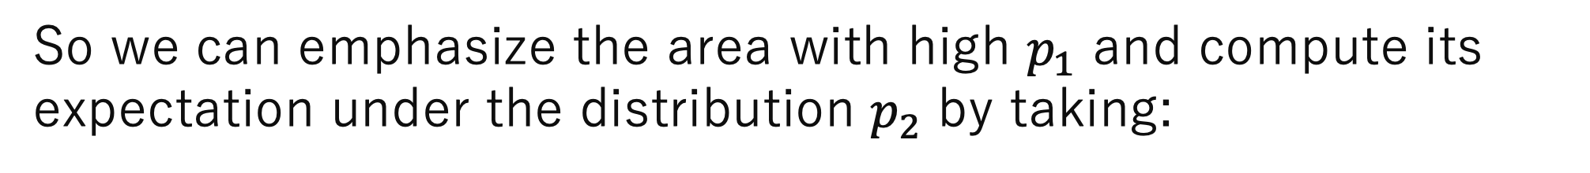
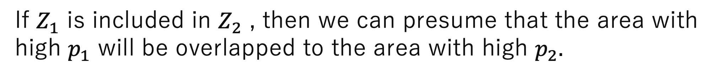
Proposed Method: ProLIP – Inclusion Loss
IDEA: If text/image loses information (masked), the original sample distribution should be included in the masked distribution.
GOAL: To design an objective function enforcing a random variable $Z_{1}$ to be included in another random variable $Z_{2}$
Let $p_{1}$ and $p_{2}$ be the probability density function of $Z_{1}$ and $Z_{2}$
If $Z_{1}$ is included in $Z_{2}$ , then we can presume that the area with high $p_{1}$ will be overlapped to the area with high $p_{2}.$
So we can emphasize the area with high $p_{1}$ and compute its expectation under the distribution $p_{2}$ by taking:

Slide 32
Proposed Method: ProLIP – Inclusion Loss
IDEA: If text/image loses information (masked), the original sample distribution should be included in the masked distribution.
GOAL: To design an objective function enforcing a random variable $Z_{1}$ to be included in another random variable $Z_{2}$
Let $p_{1}$ and $p_{2}$ be the probability density function of $Z_{1}$ and $Z_{2}$
If $Z_{1}$ is included in $Z_{2}$ , then we can presume that the area with high $p_{1}$ will be overlapped to the area with high $p_{2}.$
So we can emphasize the area with high $p_{1}$ and compute its expectation under the distribution $p_{2}$ by taking:

Slide 33
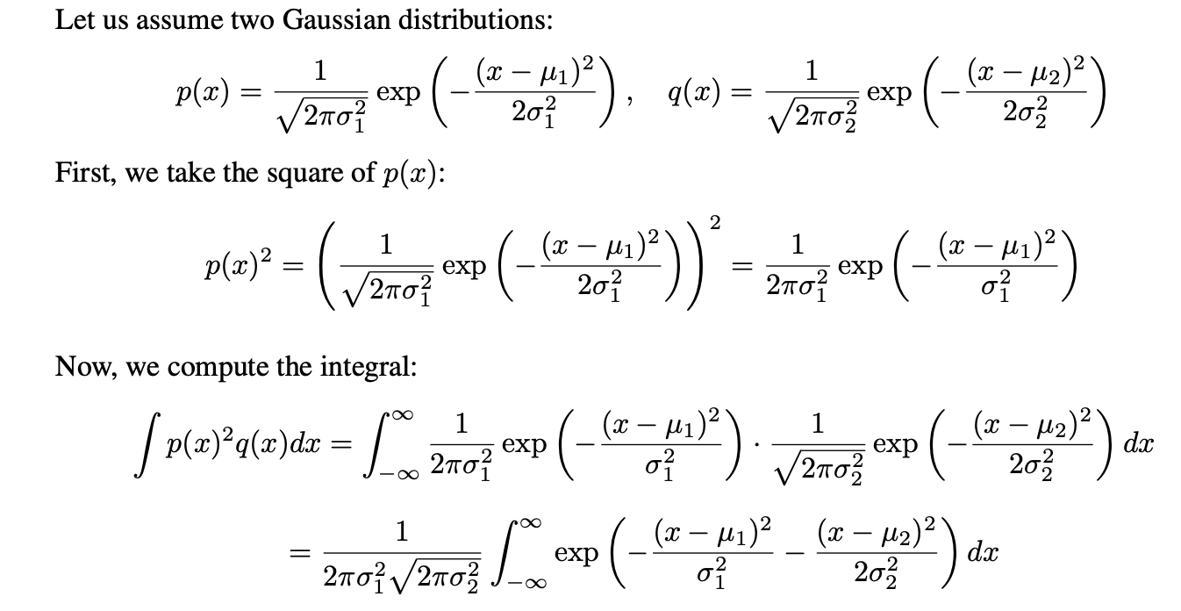
Proposed Method: ProLIP – Inclusion Loss

Slide 34
Proposed Method: ProLIP – Inclusion Loss

Slide 35
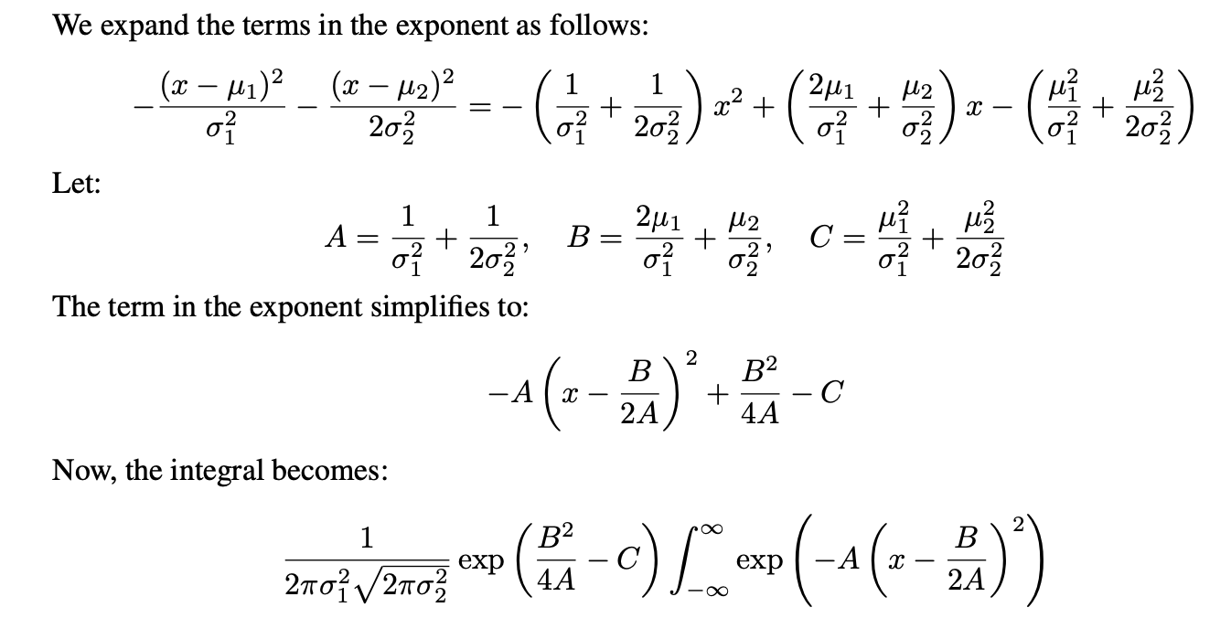
Proposed Method: ProLIP – Inclusion Loss

Slide 36
Proposed Method: ProLIP – Inclusion Loss

Slide 37
Proposed Method: ProLIP – Inclusion Loss

Slide 38
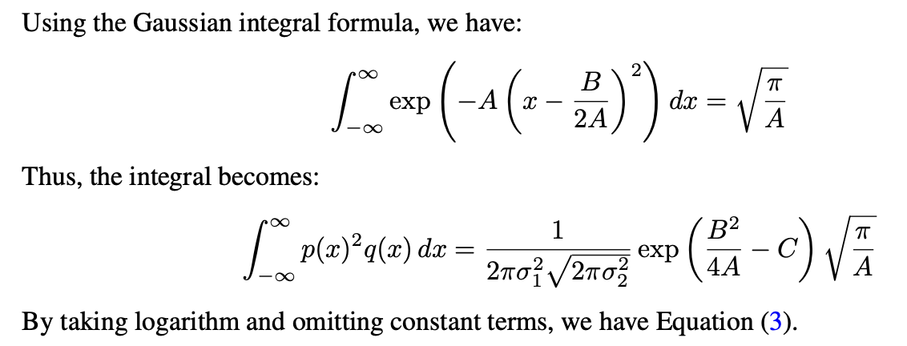
Proposed Method: ProLIP – Inclusion Loss

Slide 39
Proposed Method: ProLIP – Inclusion Loss

Slide 40
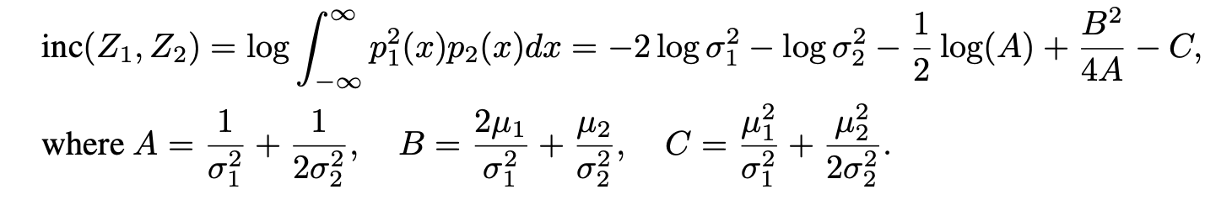
Proposed Method: ProLIP – Inclusion Loss

Slide 41
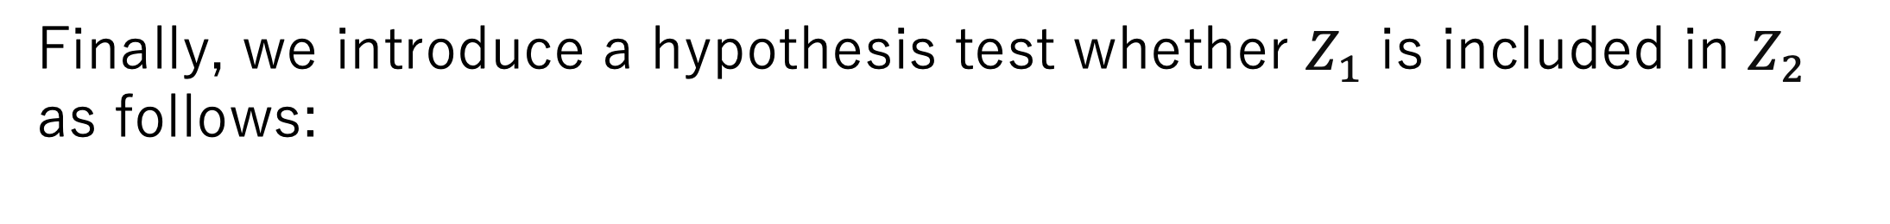
Proposed Method: ProLIP – Inclusion Loss
Finally, we introduce a hypothesis test whether $Z_{1}$ is included in $Z_{2}$ as follows:

Slide 42
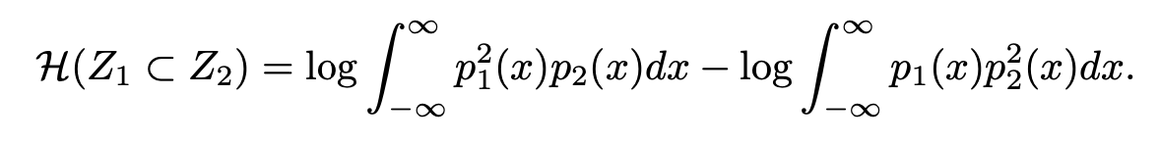
Proposed Method: ProLIP – Inclusion Loss
Finally, we introduce a hypothesis test whether $Z_{1}$ is included in $Z_{2}$ as follows:

Slide 43
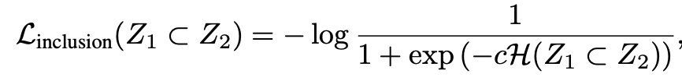
Proposed Method: ProLIP – Inclusion Loss
Finally, we introduce a hypothesis test whether $Z_{1}$ is included in $Z_{2}$ as follows:
By taking the log sigmoid loss and addind a learnable scalar $c$:

Slide 44
Experimental settings: Training and evaluation
Model:
Image encoder: ViT-B/16
Text encoder: 12-layers 768-wide Transformer
Context length: 64 tokens
Evaluation:
38 tasks of Datacomp
HierarCaps dataset
Training:
32 NVIDIA H100 GPUs with Bfloat16 precision
1 day for 1.28B seen samples

Slide 45
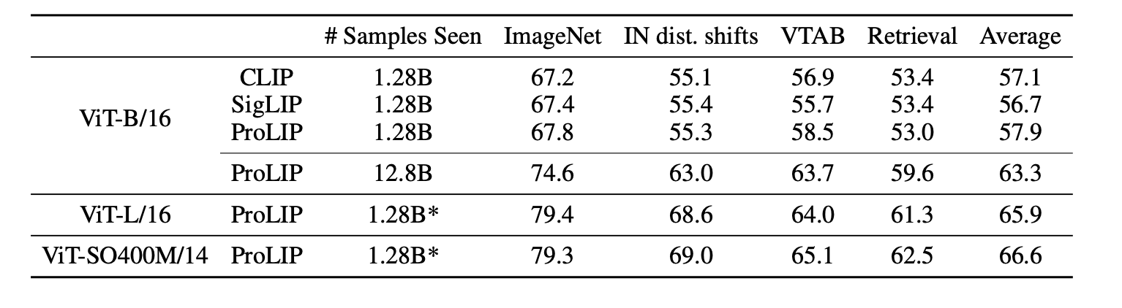
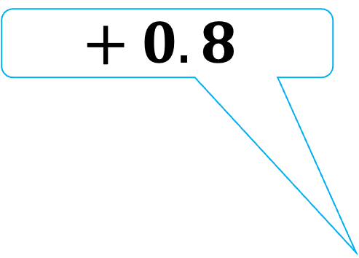
Quantitative results : ProLIP outperformed the baselines and scaled well with bigger model and data
Zero-shot classification: Using CSD, the nearest class text embedding is predicted
$$+ 0.8$$

Slide 46
Quantitative results : ProLIP outperformed the baselines and scaled well with bigger model and data
Zero-shot classification: Using CSD, the nearest class text embedding is predicted
ProLIP scaled well with bigger model or more training data

Slide 47
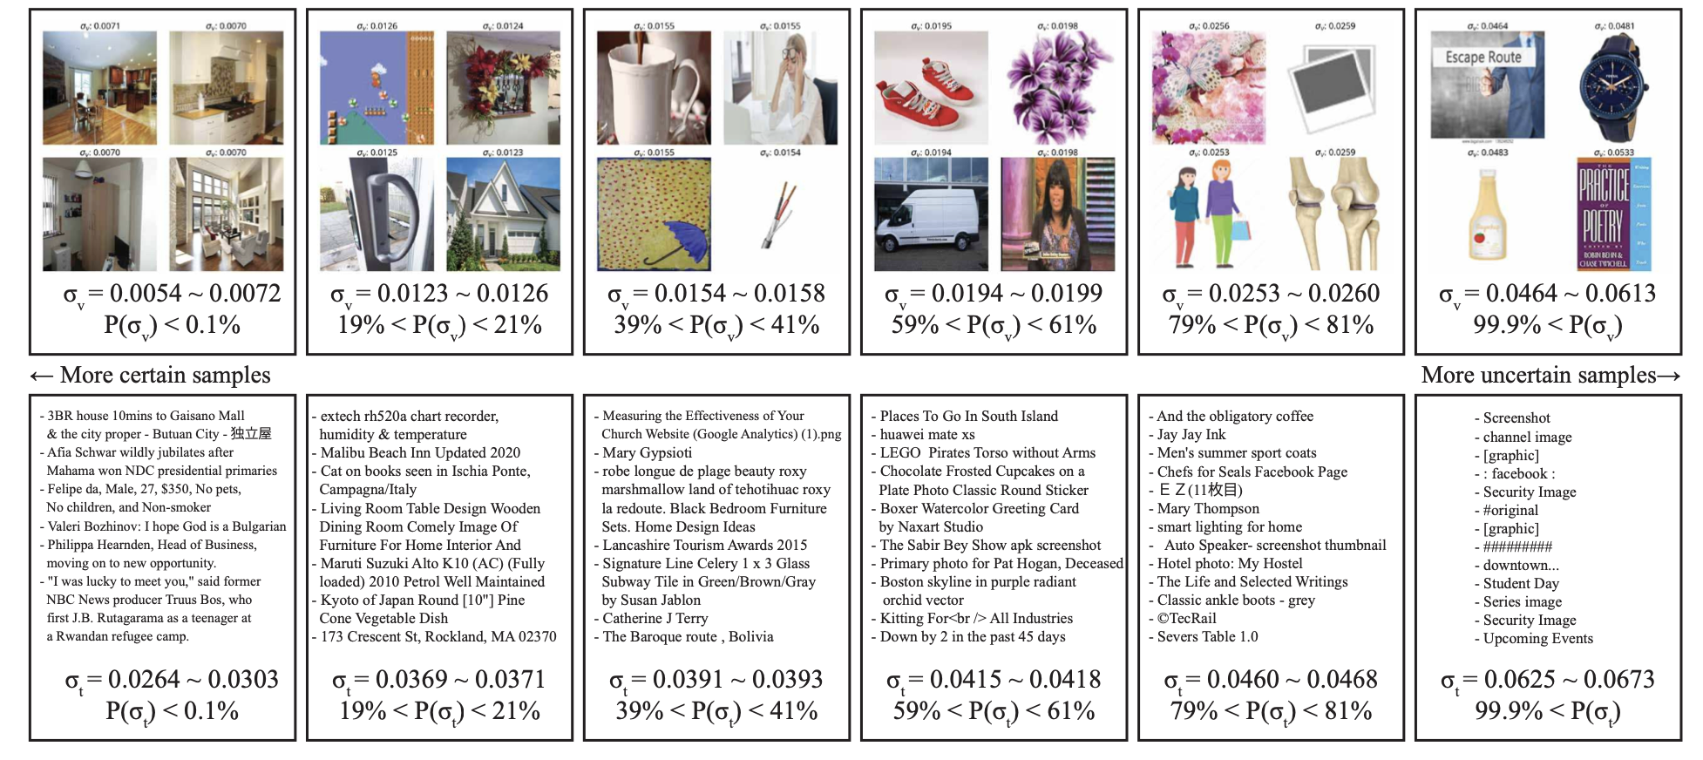
Quantitative results : Understanding the learned uncertainty
Precise description = low uncertainty
Short/vague text = high uncertainty

Slide 48
Quantitative results : Understanding the learned uncertainty
Complex visual scenes = low uncertainty
Only one object and white background = high uncertainty

Slide 49

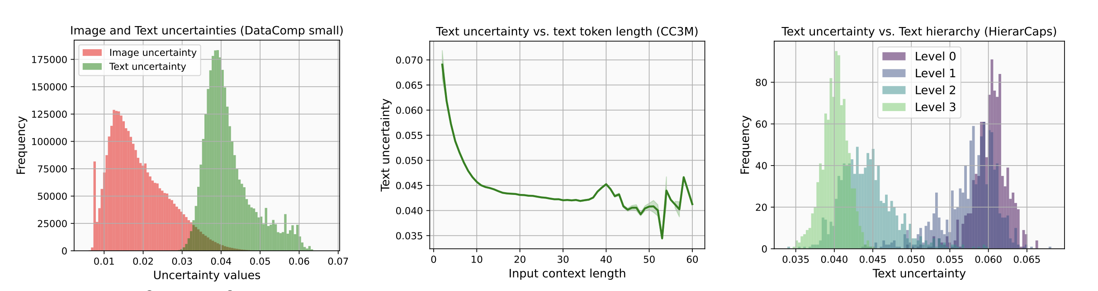
Quantitative results : Understanding the learned uncertainty
Image uncertainty
vs
Text uncertainty
Text uncertainty
vs
Token length
Text uncertainty
vs
Text hierarchy
Shorter texts are more uncertain than complex ones
More general captions (i.e., lower level) are more uncertain
Texts are more uncertain than images

Slide 50
Conclusion : A fully probabilistic vision-language model
ProLIP: Probabilistic Language-Image Pre-training
Addresses the limitations of deterministic embeddings.
Only uses a new [UNC] token = no additional parameters.
High interpretability.
Limitations :
Diagonal covariance may be insufficient to represent compared to the full covariance.
PPCL and Inclusion loss only work for normal distributions.

Slide 51
My thoughts : A meaningful paper with detailed explanations
Strength:
Solid mathematics background.
Very detailed experiments and applications.
Weakness :
Small zero-shot classification accuracy improvement.
Opinion:
May be fine-tuned on new datasets and used for XAI purpose.

Slide 52
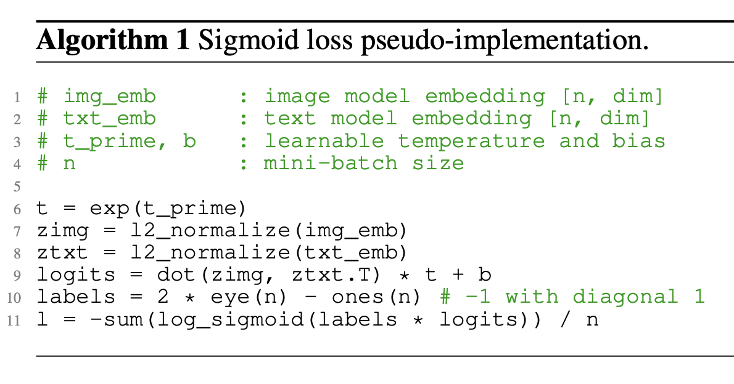
Appendix: SigLIP loss

Slide 53
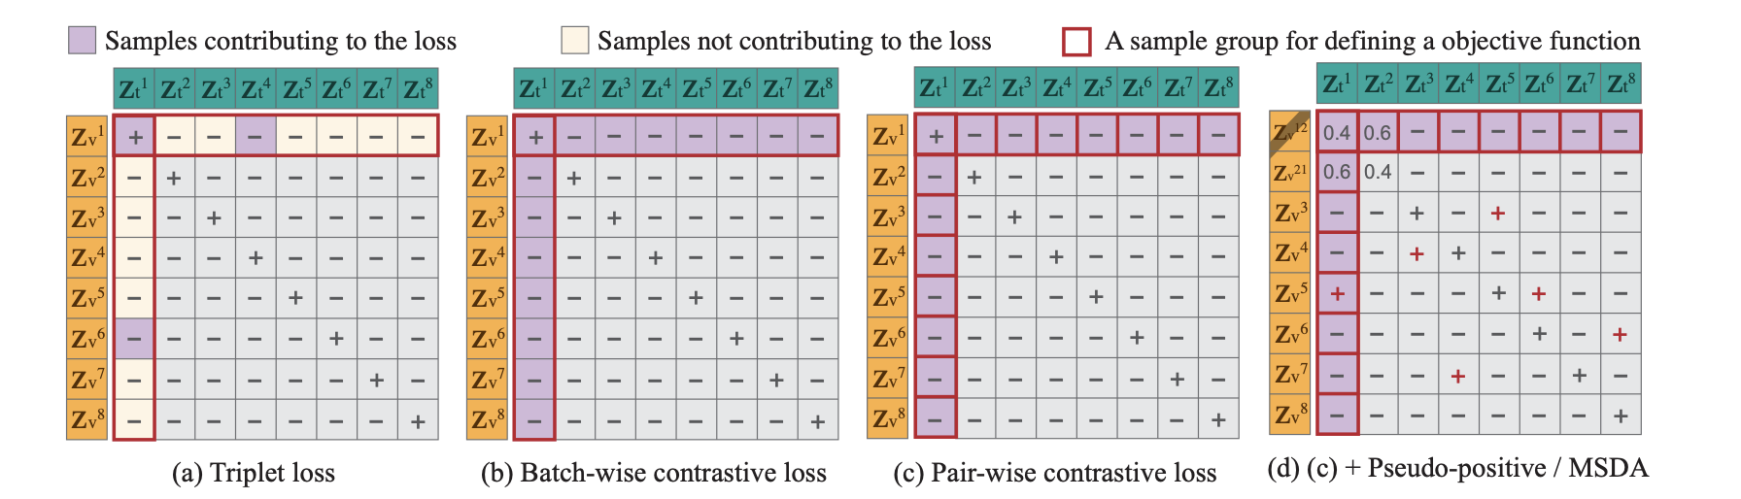
Appendix: Pair-wise contrastive loss computation

Slide 54
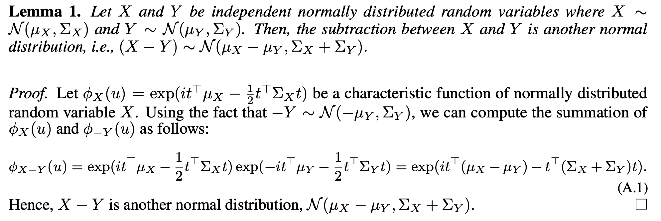
Appendix: Proof for equation (1) - 1/2

Slide 55
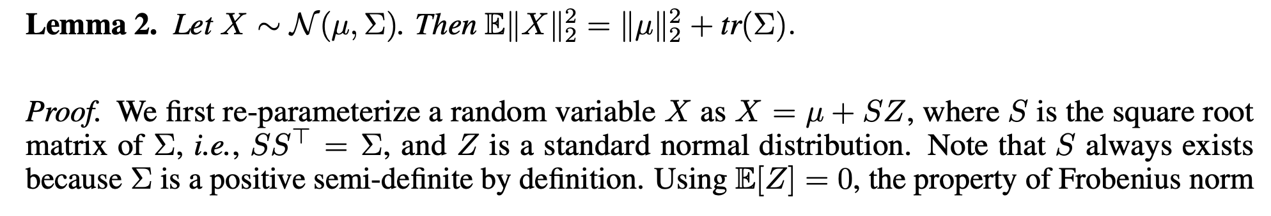
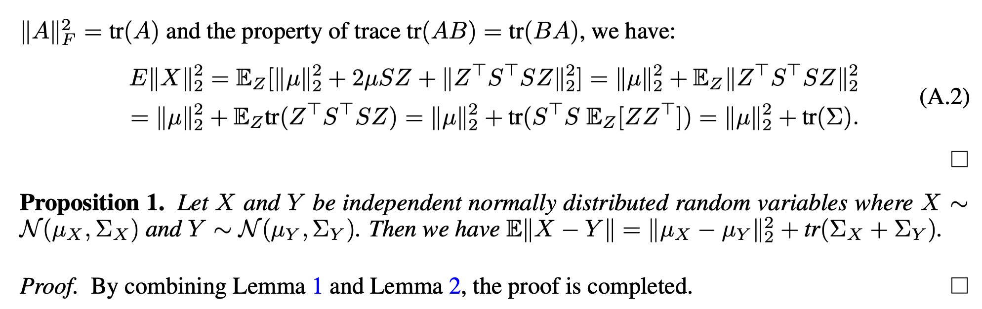
Appendix: Proof for equation (1) – 2/2

Slide 56
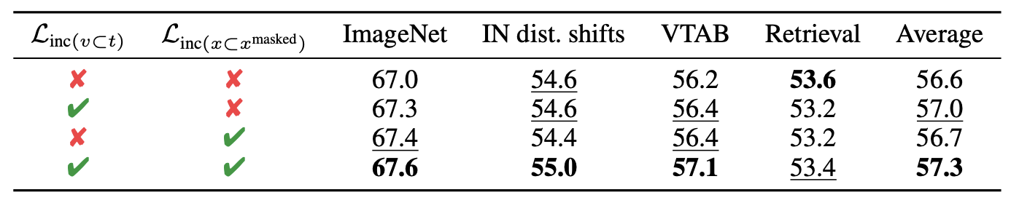
Appendix: Ablation study for the inclusion loss

